Slide 1
⭐️ 5B Food Vlogs ⭐️
Live Premiere 11/21/2025

Slide 2
Information on the grading
Sent on time? (Script, Video)
(4 Phases of our Project!) (15%)
Quality of your script?
(Structure, Content, Words and phrases) (70%)
Presentation?
(Editing, Images/Videos, Visual storytelling) (15%)

Slide 3
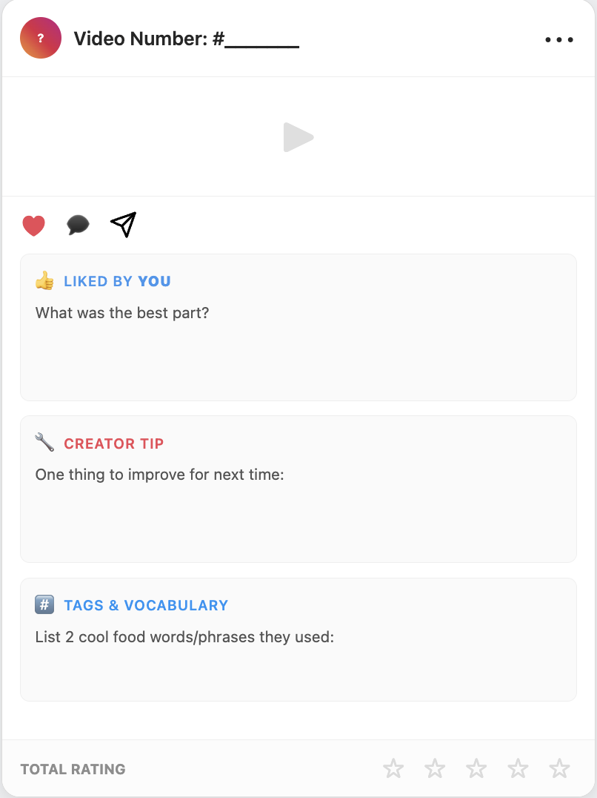
The “art” of giving feedback
Write the video number and fill out the feedback form for each clip!

Slide 4
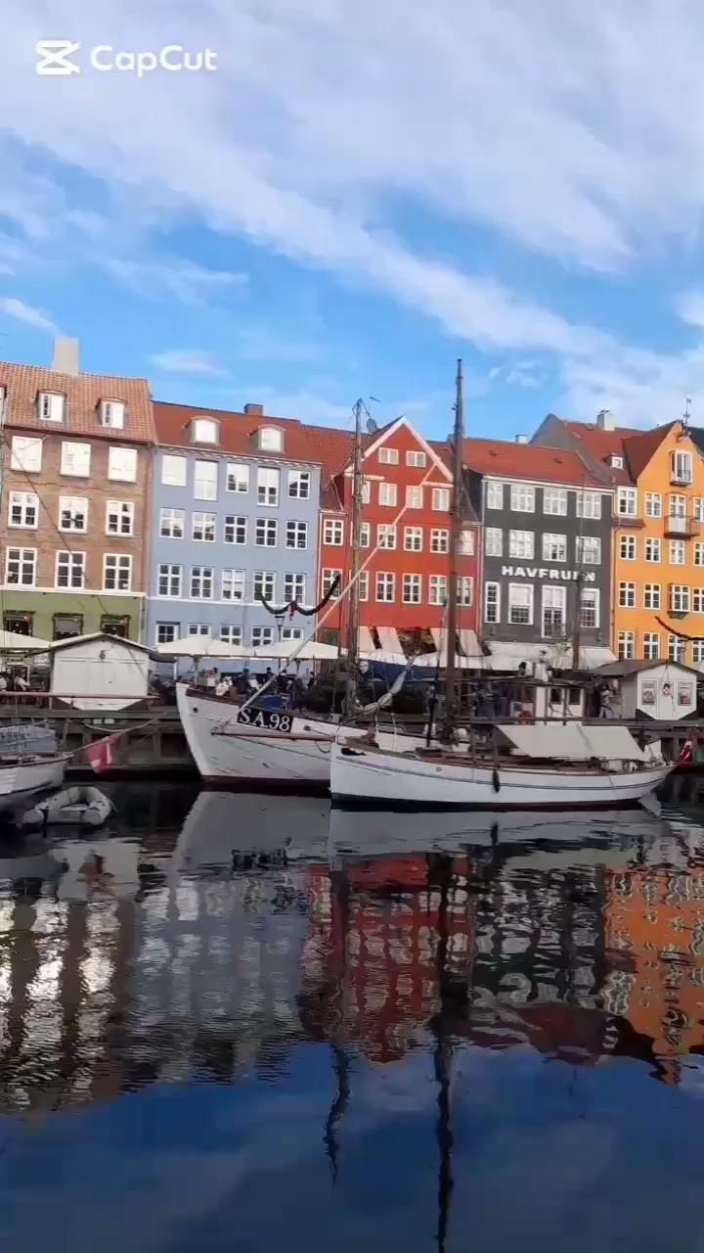
Video #1
Copenhagen

Slide 5
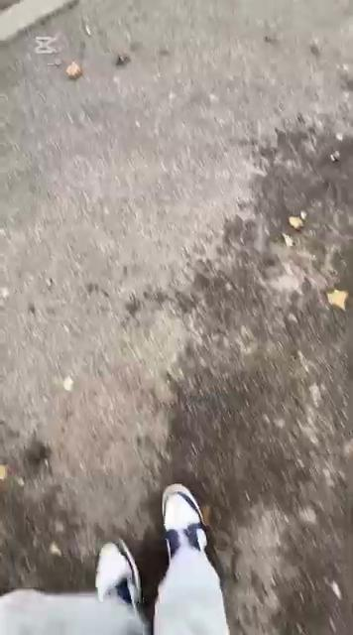
Video #2
Futterboden

Slide 6
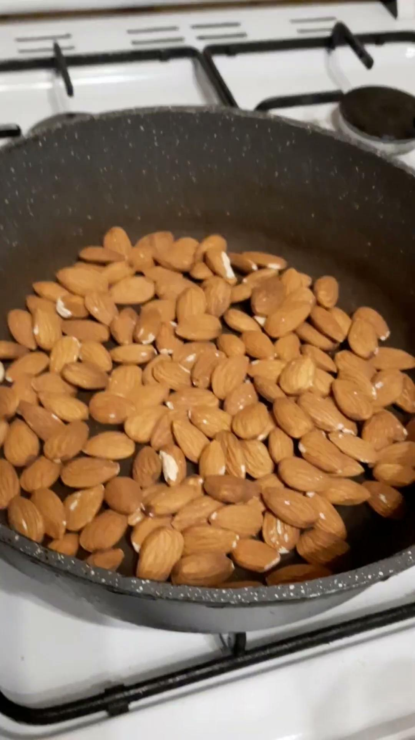
Video #3
Roasted
Almonds

Slide 7

Video #4
Pars

Slide 8
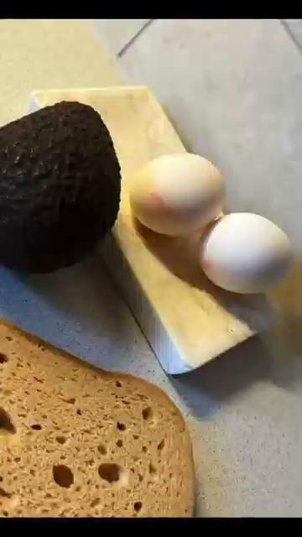
Video #5
Healthy
Breakfast

Slide 9
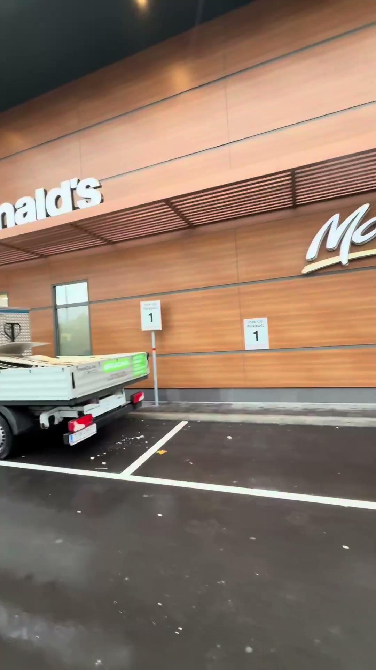
Video #6
McDonalds

Slide 10

Video #7
Italy

Slide 11
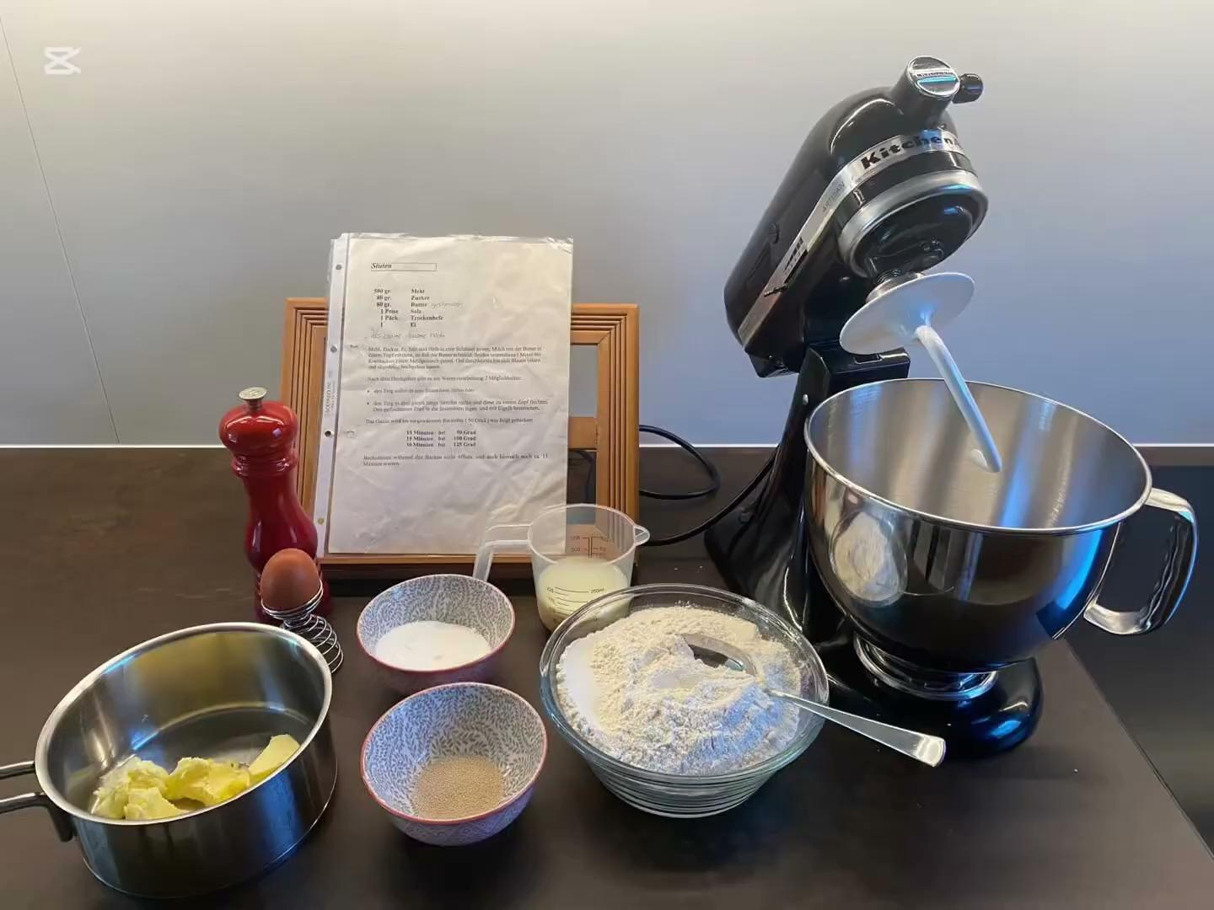
Video #8
Hefezopf

Slide 12
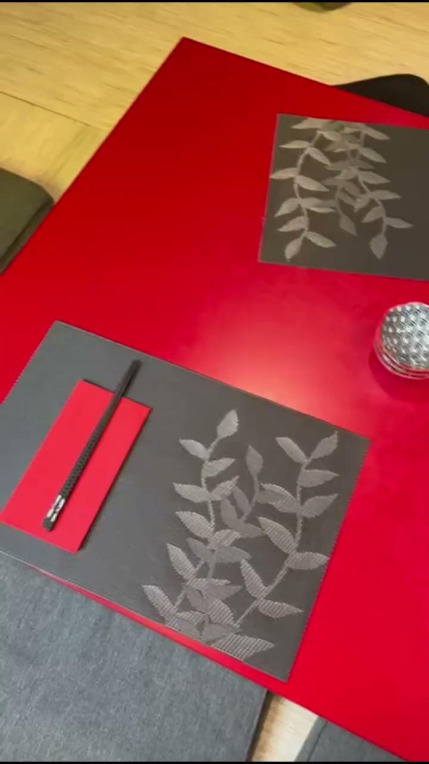
Video #9
Yume

Slide 13

Video #10
Jin’s

